Slide 1


Banking that is always on course

Slide 2

Meet Bushwood Bank’s Management Team

Slide 3


Bushwood Community Bank is committed to staying always on course; Delivering steady, reliable financial services our community can trust through every season of life.

Slide 4

At the Start of our Course
Assets
628 MM
922 MM
NIM
3.24
5.30
ROE
3.85
22.74
ROA
.24
1.57
Loans
781 MM
737 MM

Slide 5
Our Drive Towards Success
Control
Profit
Risk
Growth

Slide 7
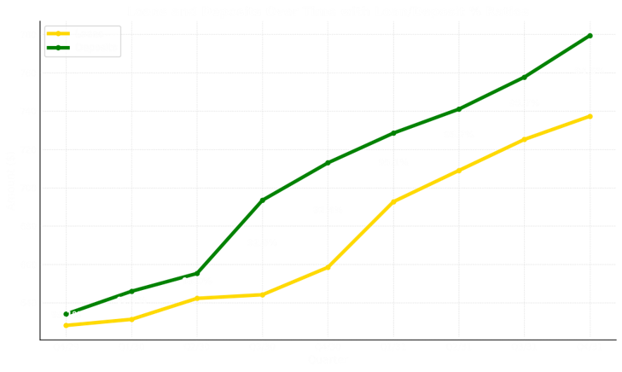

Slide 8

Net Income
NIM
3.6
5.3%
0.46
3.24%
ROE
ROA
22.74%
1.57%
3.85%
.24%

Slide 9
Efficiency Ratio
Stock Price
56.29%
38.21
77.98%
17.72
Net Liquid Assets / Total Assets
1.63
-1.19

Slide 10

Our FOREcast for the Future
Maintain Control
Profitability
Stability
Build Relationships
Reinforce Trust

Slide 11
Our FOREcast for the Future
Assets
Stock Price
$1.5 MM +
$50 + $60

Slide 12

Thank you for making this round with us one to remember!

