Slide 1

Banking that grows with you

Slide 2
Our Management Team

Slide 3
Where we started
Total Assets
$781 MM
Loans
$628 MM
Deposits
$671 MM
ROE
3.85%
ROA
0.24%
NIM
3.24%

Slide 4
Areas of Concern
Ineffective Loan & Deposit Pricing
Weak Earnings
Downward trend in ROA, ROE, NIM
Worsening Efficiency Ratio
Inadequate Liquidity
Low Stock Price

Slide 5
Strategy
Sustainable Growth
Minimize Credit Risk
Disciplined Loan Growth
Focus on Core Deposit Relationships
Protect & Increase Shareholder Value

Slide 6
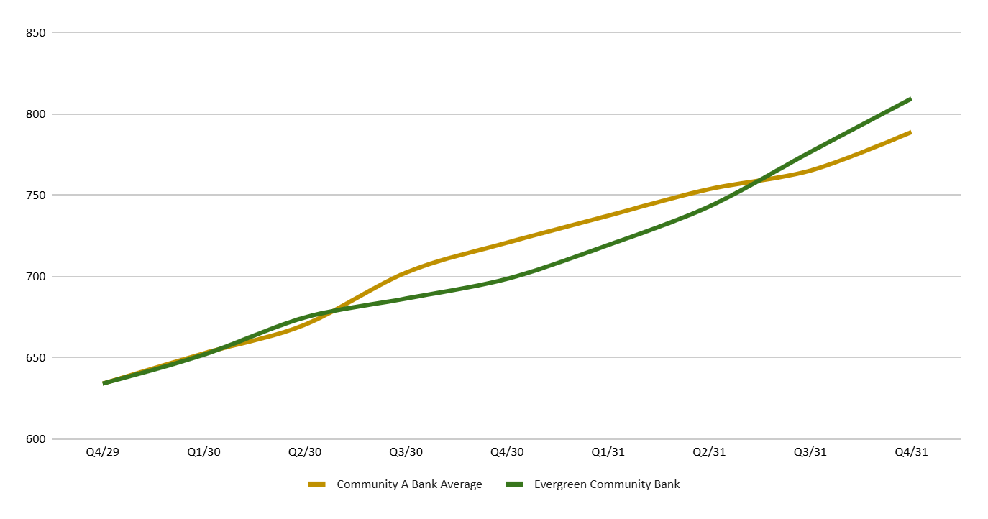
Total Deposits
Started
$671MM
Current
$809
MM

Slide 7
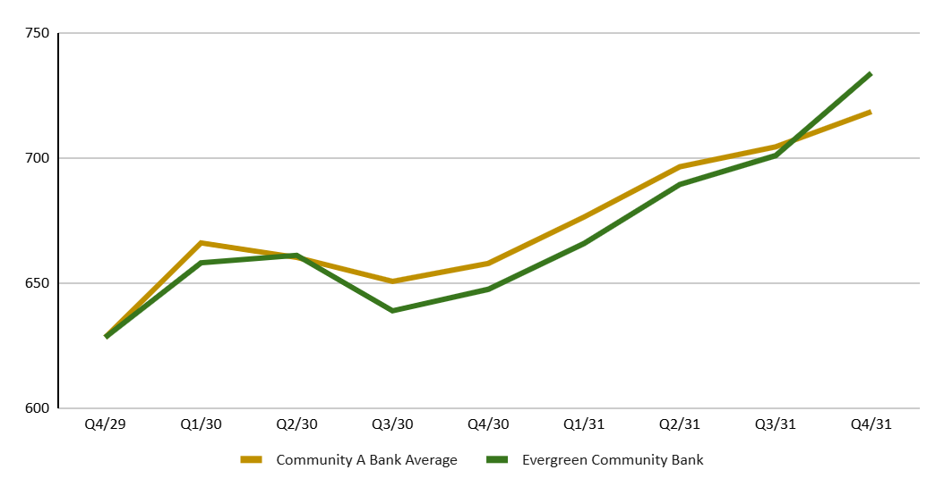
Loans
Started
$628
MM
Current
$734
MM

Slide 8
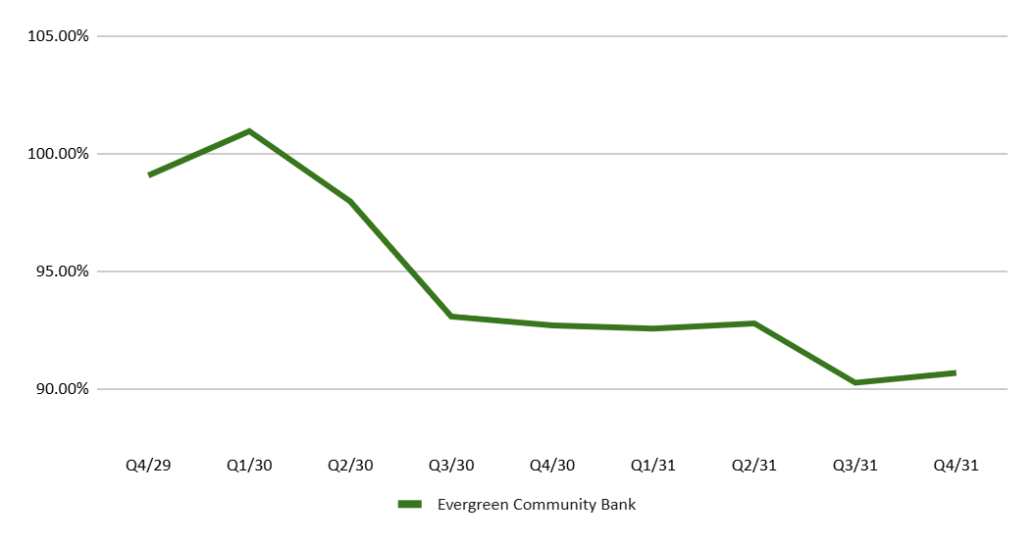
Loans to Deposits
Started
99%
Current
91%

Slide 9
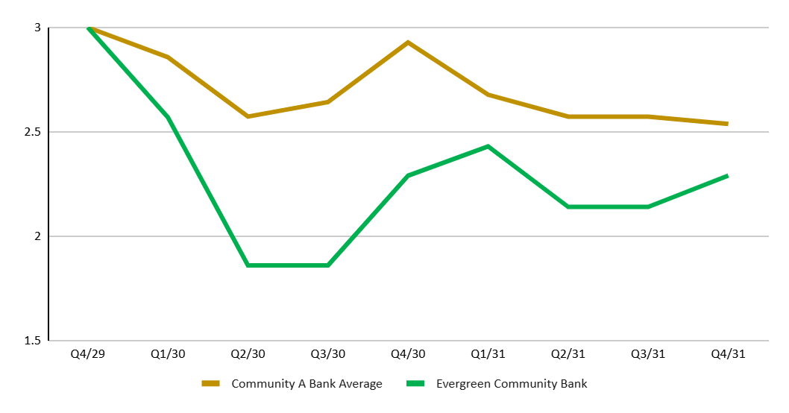
Credit Quality

Slide 10
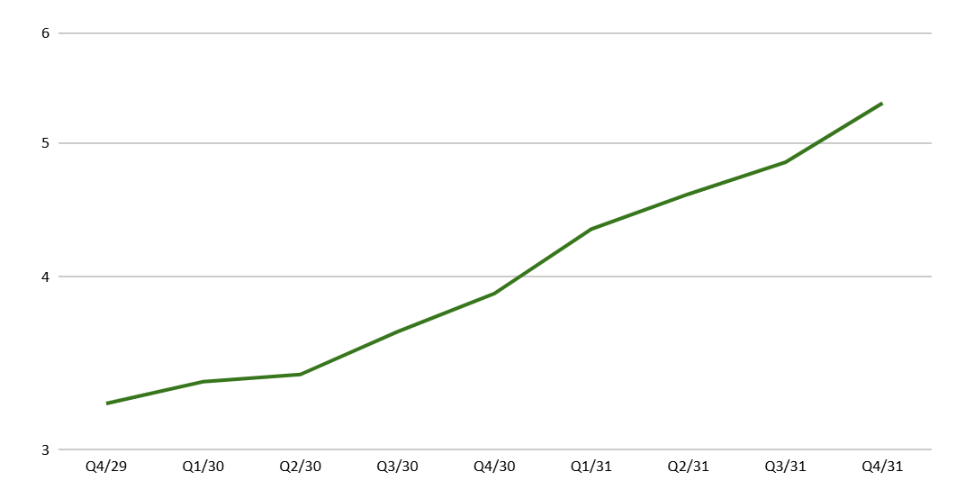
Net Interest Margin
Started
3.24%
Current
5.34%

Slide 11
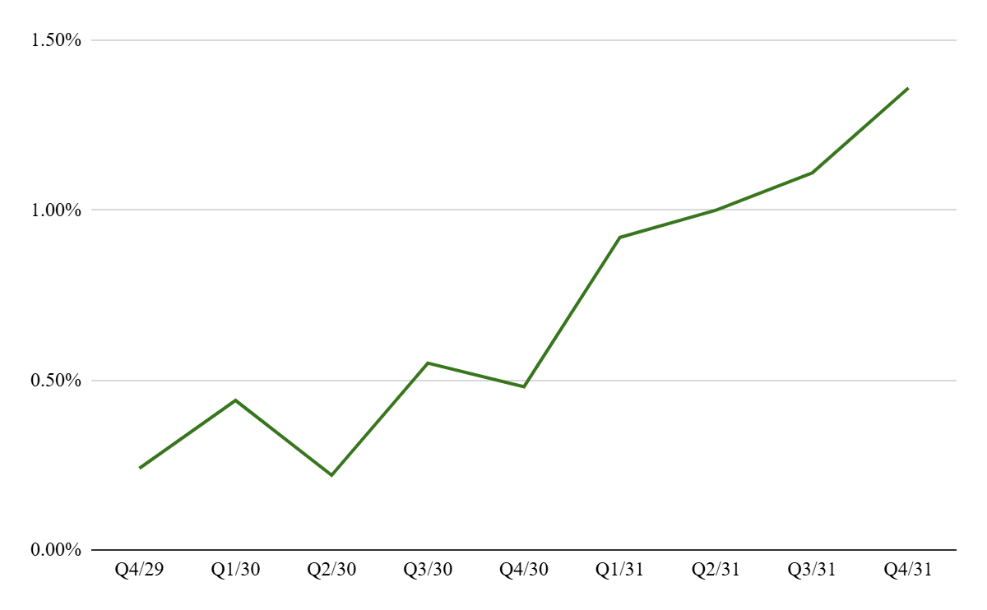
Return on Assets
Started
0.24%
Current
1.36%

Slide 12
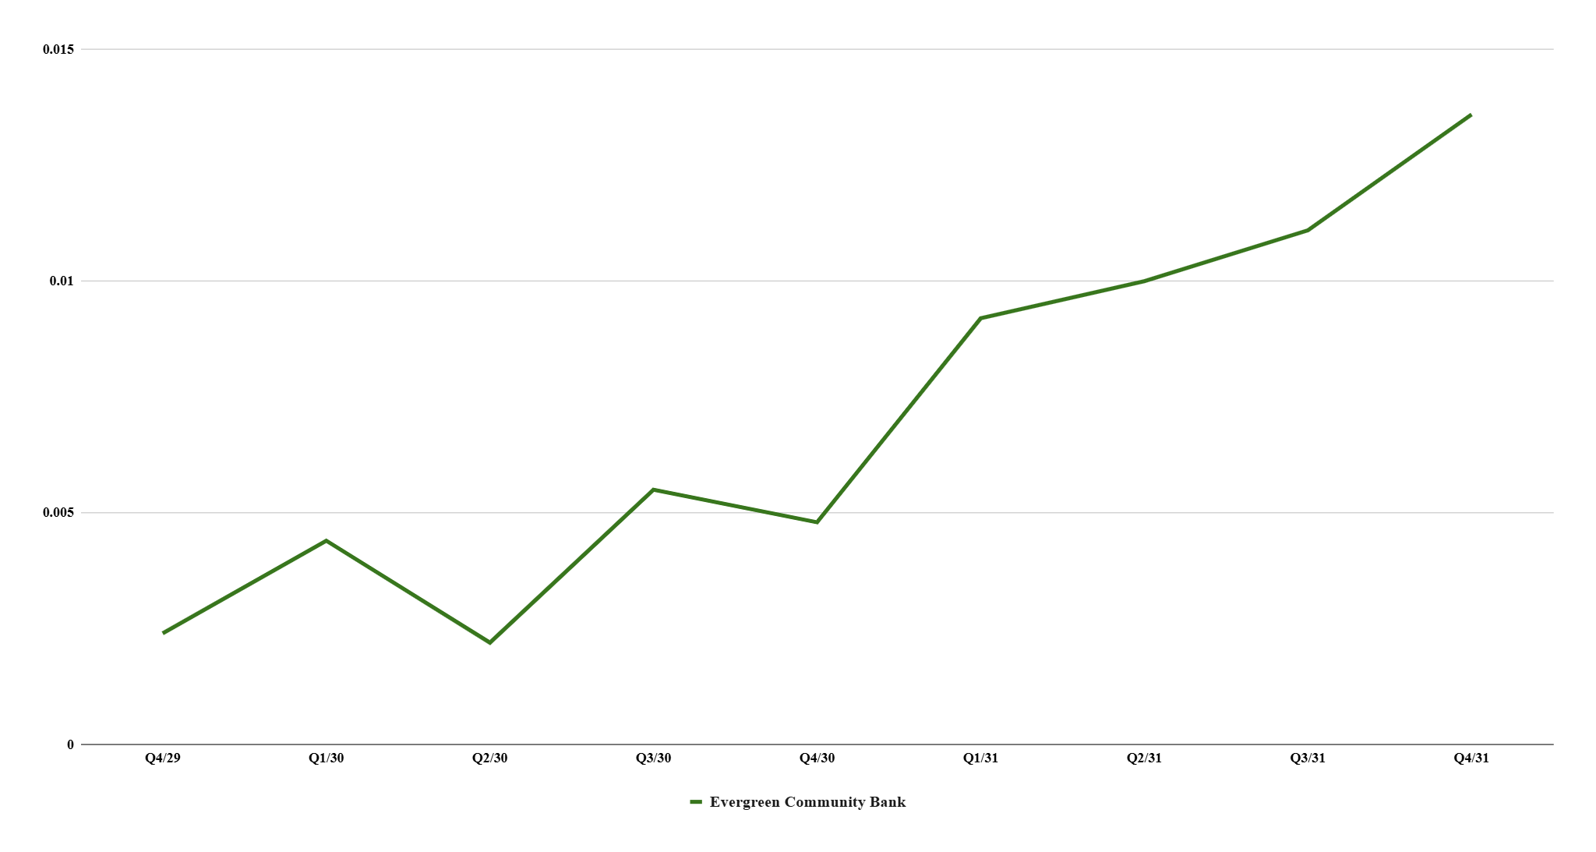
Return on Equity
Started
3.85%
Current
21.6%

Slide 13
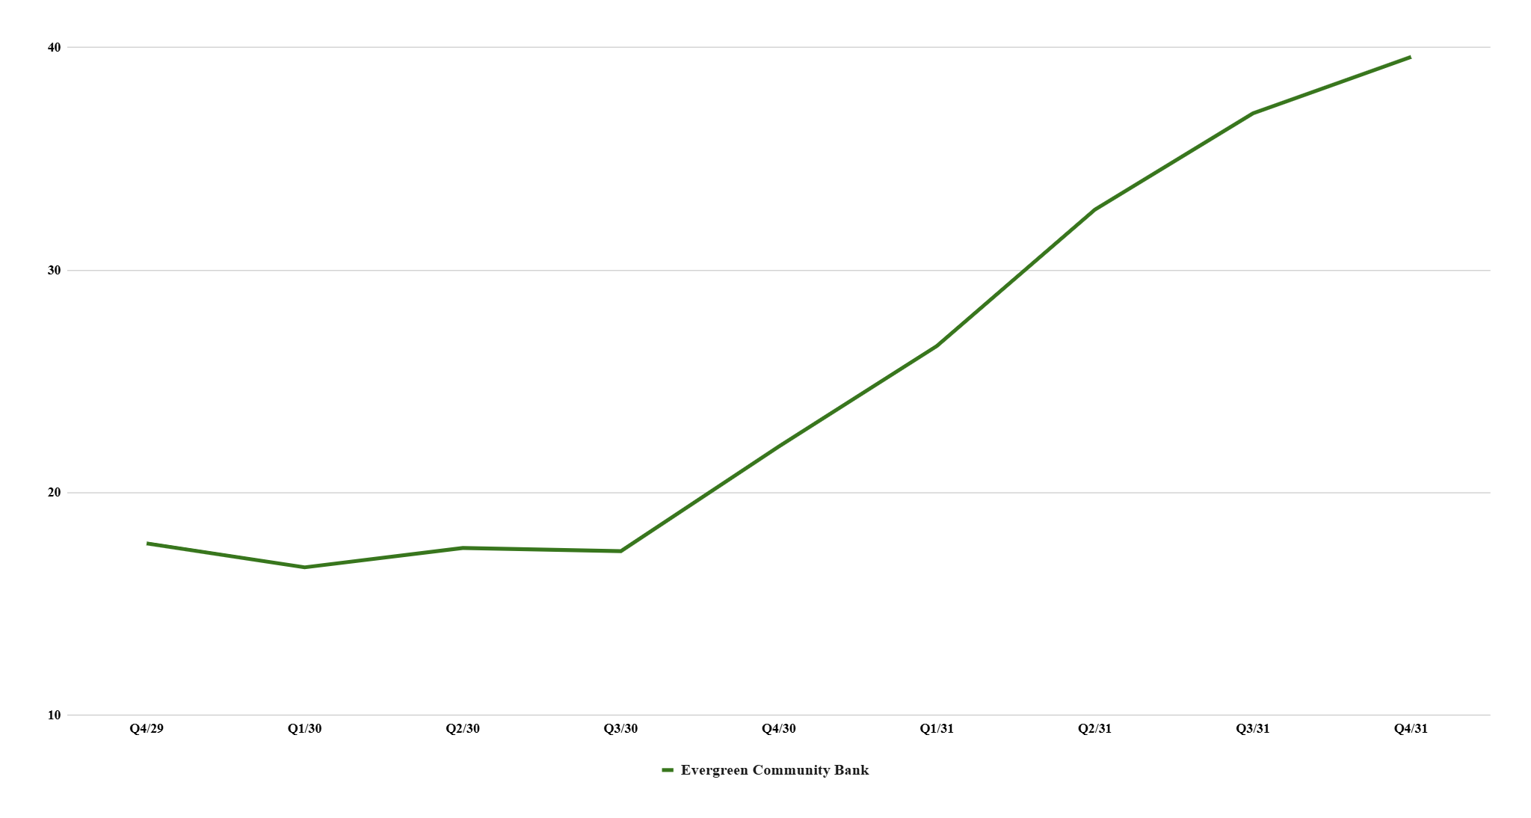
Stock Price
Started
$17.72
Current
$39.58

Slide 14
… as we grow
Maintain a healthy loan-to-deposit ratio
Maintain focus on credit quality
Disciplined Loan Growth
Continued focus on Core Deposit Relationships
Increase dividend program to return shareholder value

