Slide 1

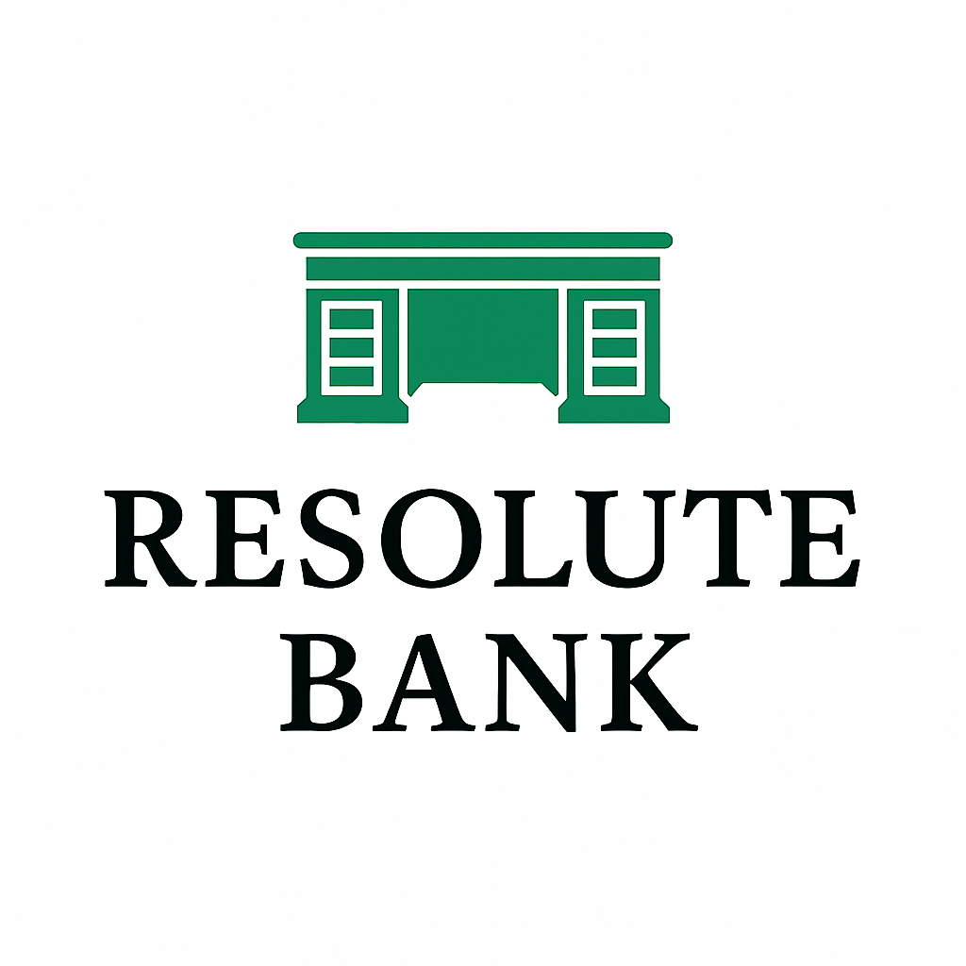
Resilient.
Reliable.
Ready.

Slide 2
About Us
Executive Management
Mission Statement
  At Resolute Bank, we provide reliable, responsible, and relationship-driven banking with a focus on long-term stability. Our mission is to grow steadily and sustainably, supporting our customers and communities every step of the way.
  Resolute (adjective): admirably purposeful, determined, and unwavering

Slide 3
Focus Areas
Management’s Top 3 Concerns:
Rapid, unsustainable loan growth
Inefficient operations compressing Net Interest Margin
Poor liquidity and over reliance on borrowed funds
Risk
Profit
Growth
Notes:
What did we identify as the bank’s biggest risk initially?
Slowing runaway loan growth
Growing reliance on borrowed funds.
Income Concerns:
Improving Efficiency Ratio
Increasing NIM
Why did we choose a more conservative growth plan?
Focused on maximizing return on current assets rather than growing rapidly

Slide 4
Goals
Slow rapid loan growth
Balance loans to deposits
Steadily increase profits
Improve efficiency ratio

Slide 5
Dec 31, 2029 vs. Dec 31, 2031
77.98
(29.81%)
54.73
Efficiency Ratio
0.24
562.50%
1.59
ROA
3.85
501.30%
23.17
ROE
3.24
63.27%
5.29
NIM

Slide 6
Risk Management

Slide 7
Regulatory Requirements

Slide 8
Regulatory Requirement Continued

Slide 9
Fed Funds Position

Slide 10
Income

Slide 11
Growth

Slide 12
Loan & Deposit Growth

Slide 13
Forward Trajectory
Maintain efficiencies
Continued shareholder value
Build on profits

Slide 14
Why invest in Resolute Bank?
Strong profitability and efficient operations.
  With a Return on Assets (ROA) of 1.59% and an outstanding Return on Equity (ROE) of 23.17%, the bank demonstrates excellent financial performance and effective use of both assets and shareholder capital.
Maintained and ultimately increased shareholder dividend.
  In the last quarter we increased the dividend by 40%.
Solid financial foundation
  Capital ratio of 9.96%
Notes:
With $850.76 million in assets, $678.02 million in loans, and $753.56 million in deposits, the bank operates at a scale that supports stability and growth. At a stock price of $41.02, its solid fundamentals make it a compelling choice for investors seeking a reliable and high-performing bank.

Slide 15
Why Invest?

Slide 16
Your bank for the next 100 years.
Here today; Here tomorrow.

