Slide 1




Slide 2
Executive Team

Slide 3
Your Path Forward Starts with a Pivot.

Slide 4



The Starting Point…
NIM
ROA
$671M
NET INCOME
77.98%
ROE
$781M
DEPOSITS
3.24%
EFFICIENCY
ASSETS
.24%
$0.46M
3.85%

Slide 5
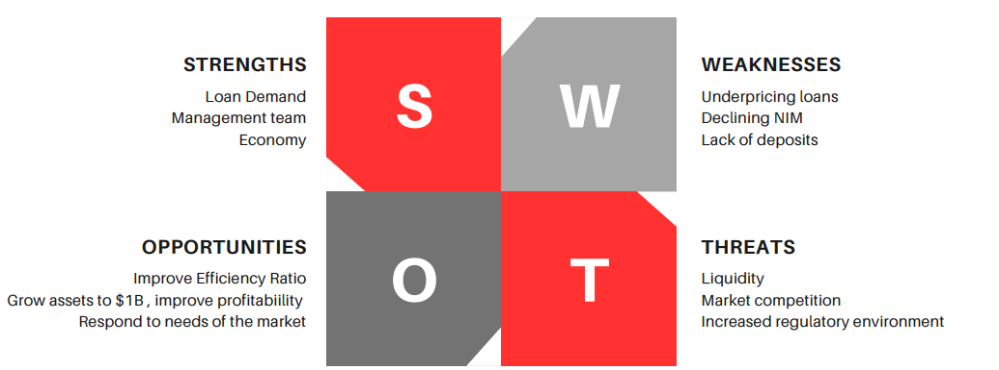

Slide 6

RISK

Slide 7

Metric
Goal
Strategy
>Pricing & Credit Quality
>Loan & Deposit Pricing
>Repricing Loan & Deposits/Eliminate Dividends
>Retain Earnings/Issue Stock
ROA
NIM
Net Income
ROE
Assets
Equity
*1.00%
*4.00%
*Hist. Profit
*10.00%
*Cont. Growth
*6.00%
$1B

Slide 8
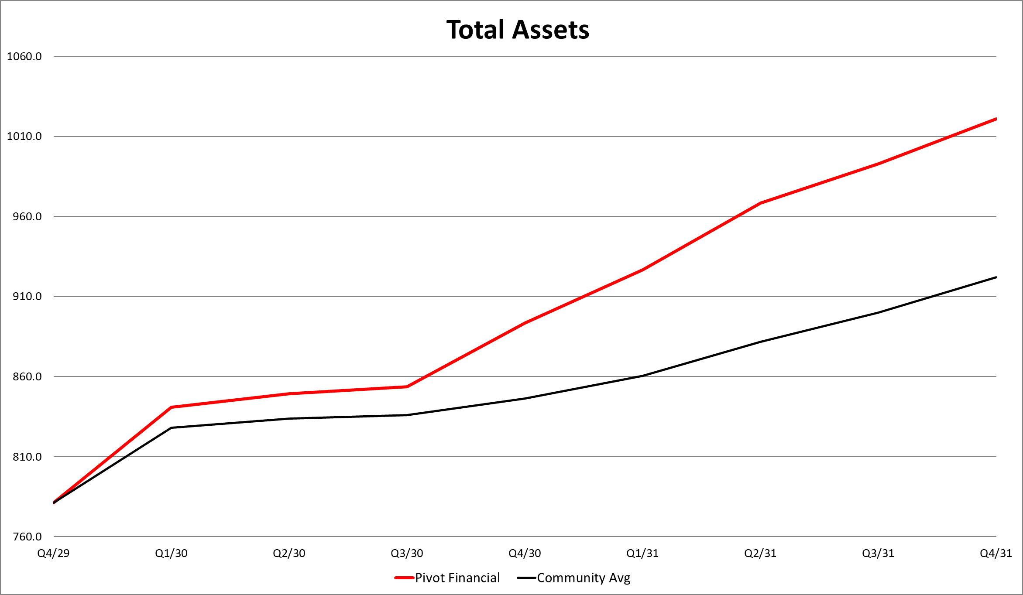

Slide 9
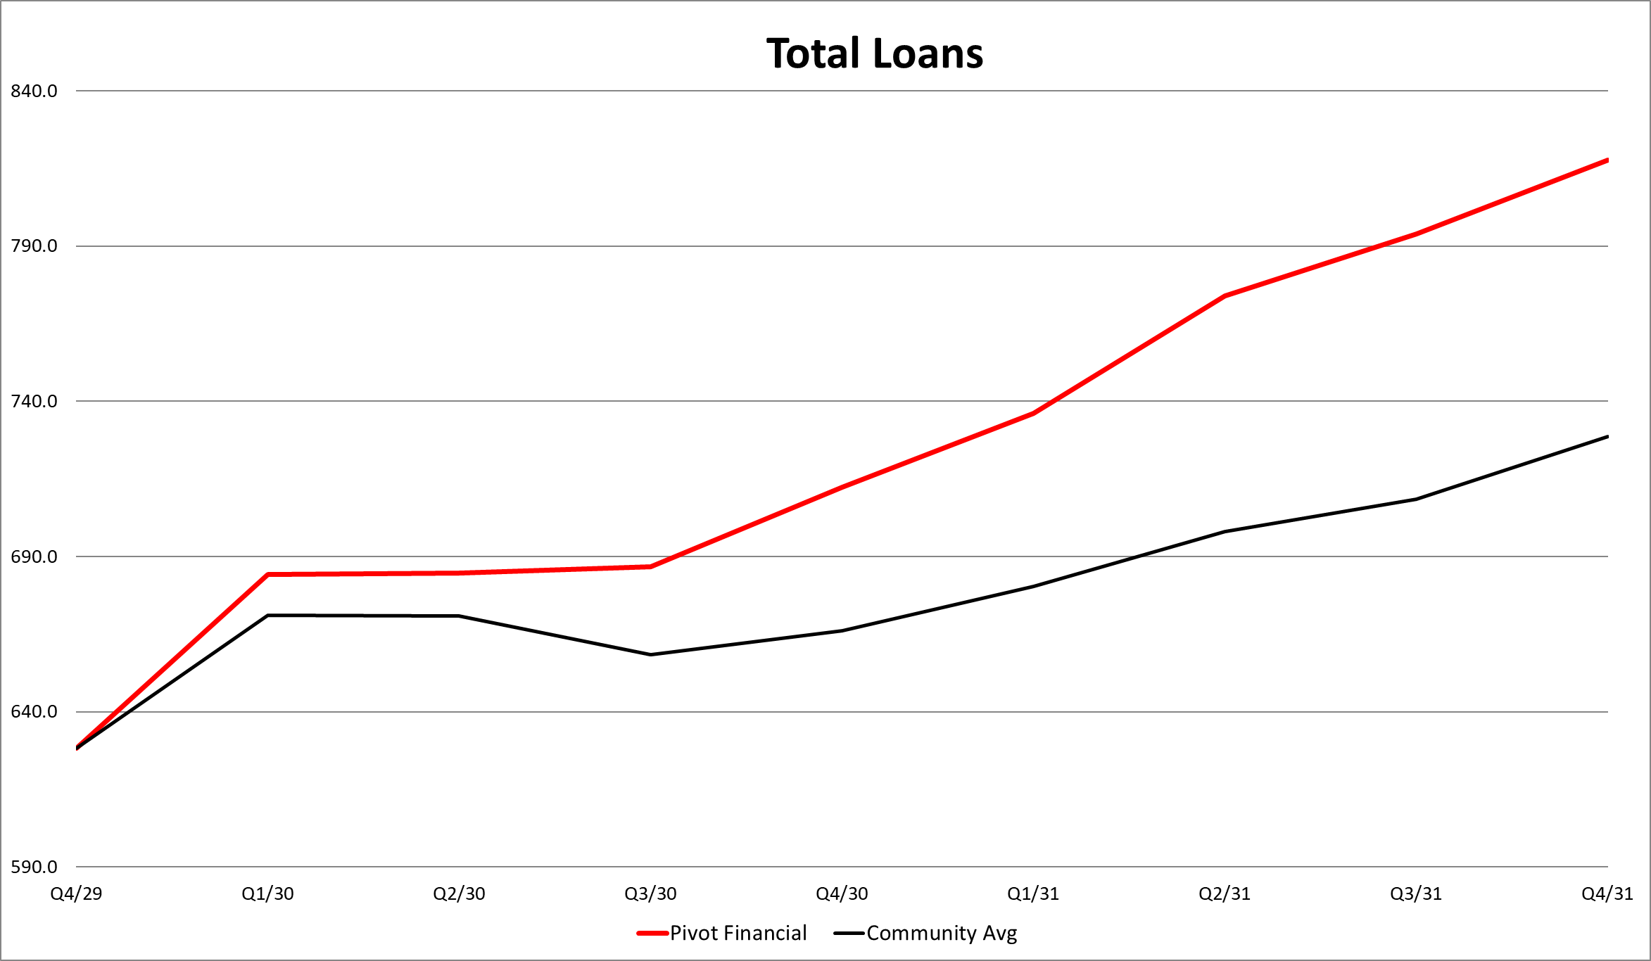

Slide 10
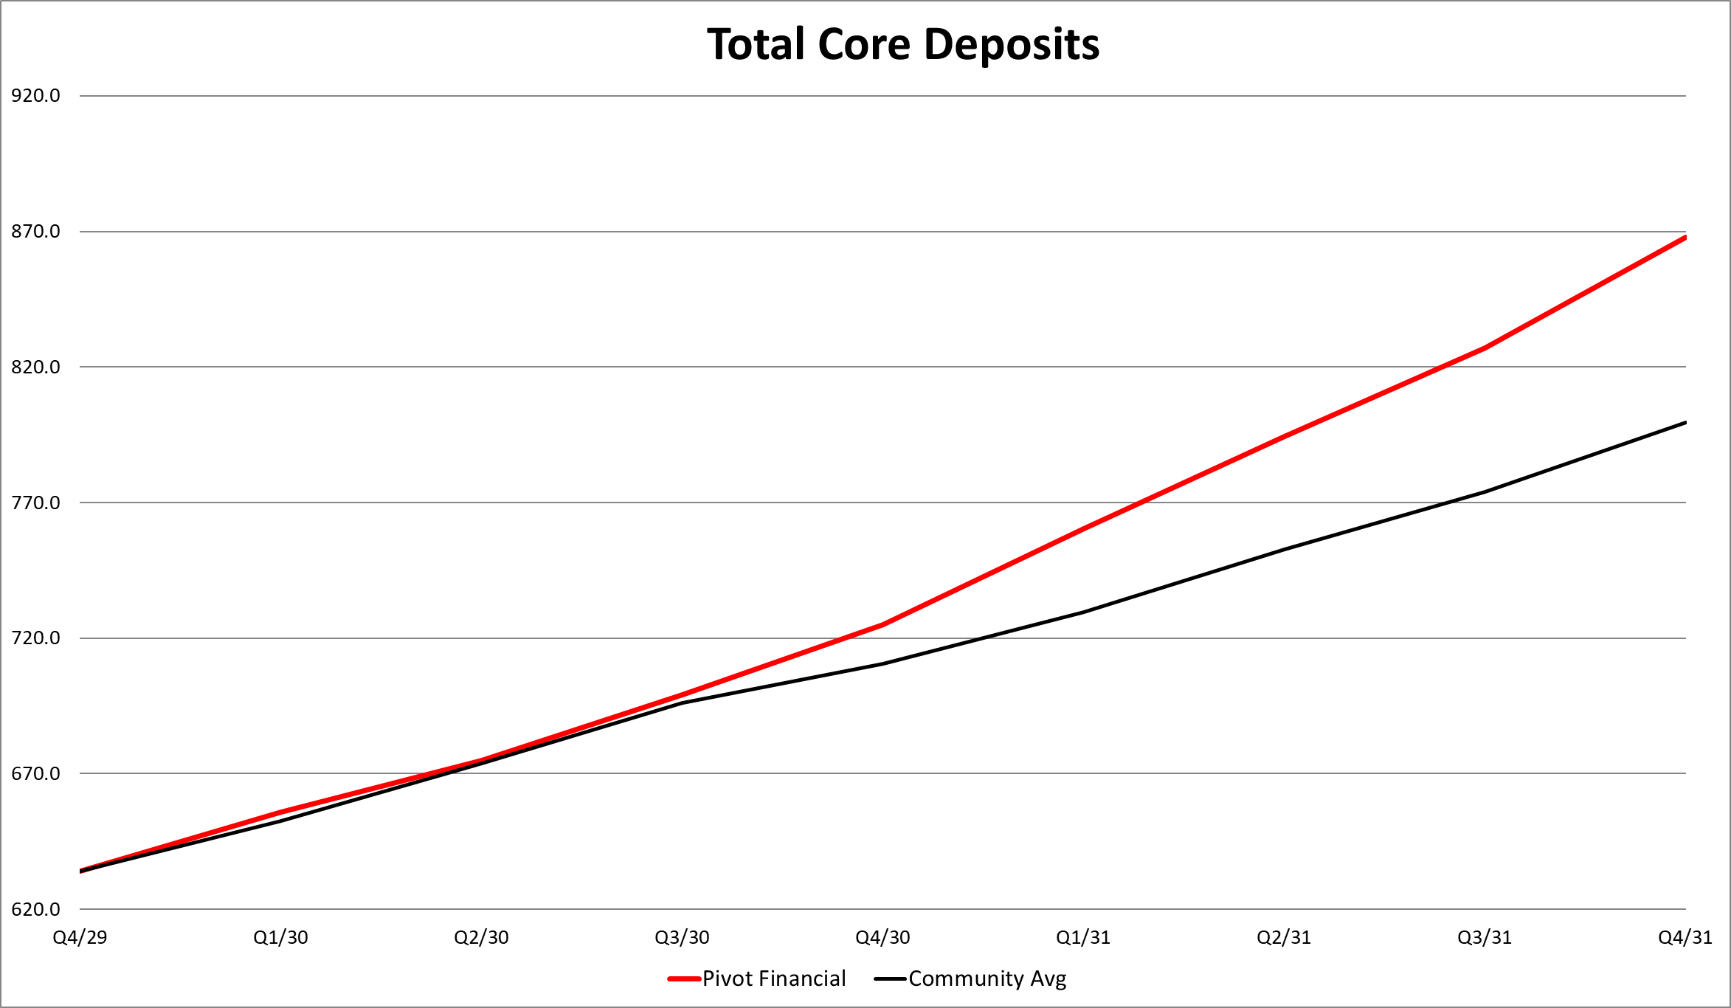

Slide 15



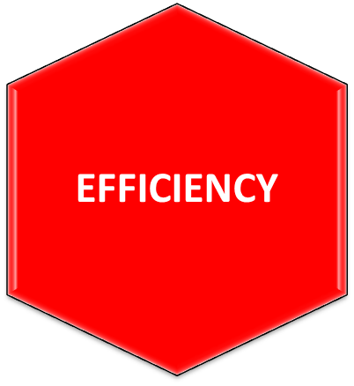



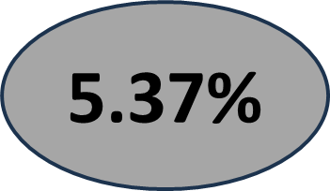

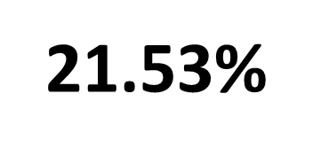
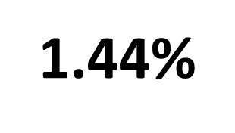
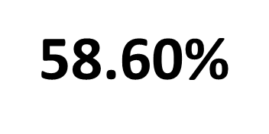
3.85%
3.254%
.24%
77.98

Slide 16






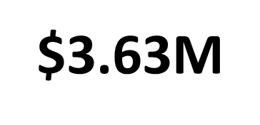
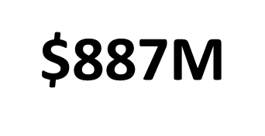
$0.46M
$671M
$781M
$1.02B

Slide 17
Thank You!!!

