Slide 1

Shaped by Time.
Steady as the Tide.
Anchored in Community.
Notes:
Good Morning!
Welcome to The Driftwood Bank. We are a coastal community bank dedicated to serving our local community.
We are..
Shaped by Time. Steady as the Tide. Anchored in Community.

Slide 2

Our Team
We are an elite group of seasoned banking executives, poised to elevate Driftwood Bank with our extensive expertise and dedication.
Notes:
With that said, I would like to introduce you to a team with over 50 years of experience in banking.
My name is Matt....
Today, we are going to take you through the results of the last 2 years. We will hit on:
- Where we started
- Our overarching strategy
- The overall results & challenges
- and finish up, focusing on the future.

Slide 3
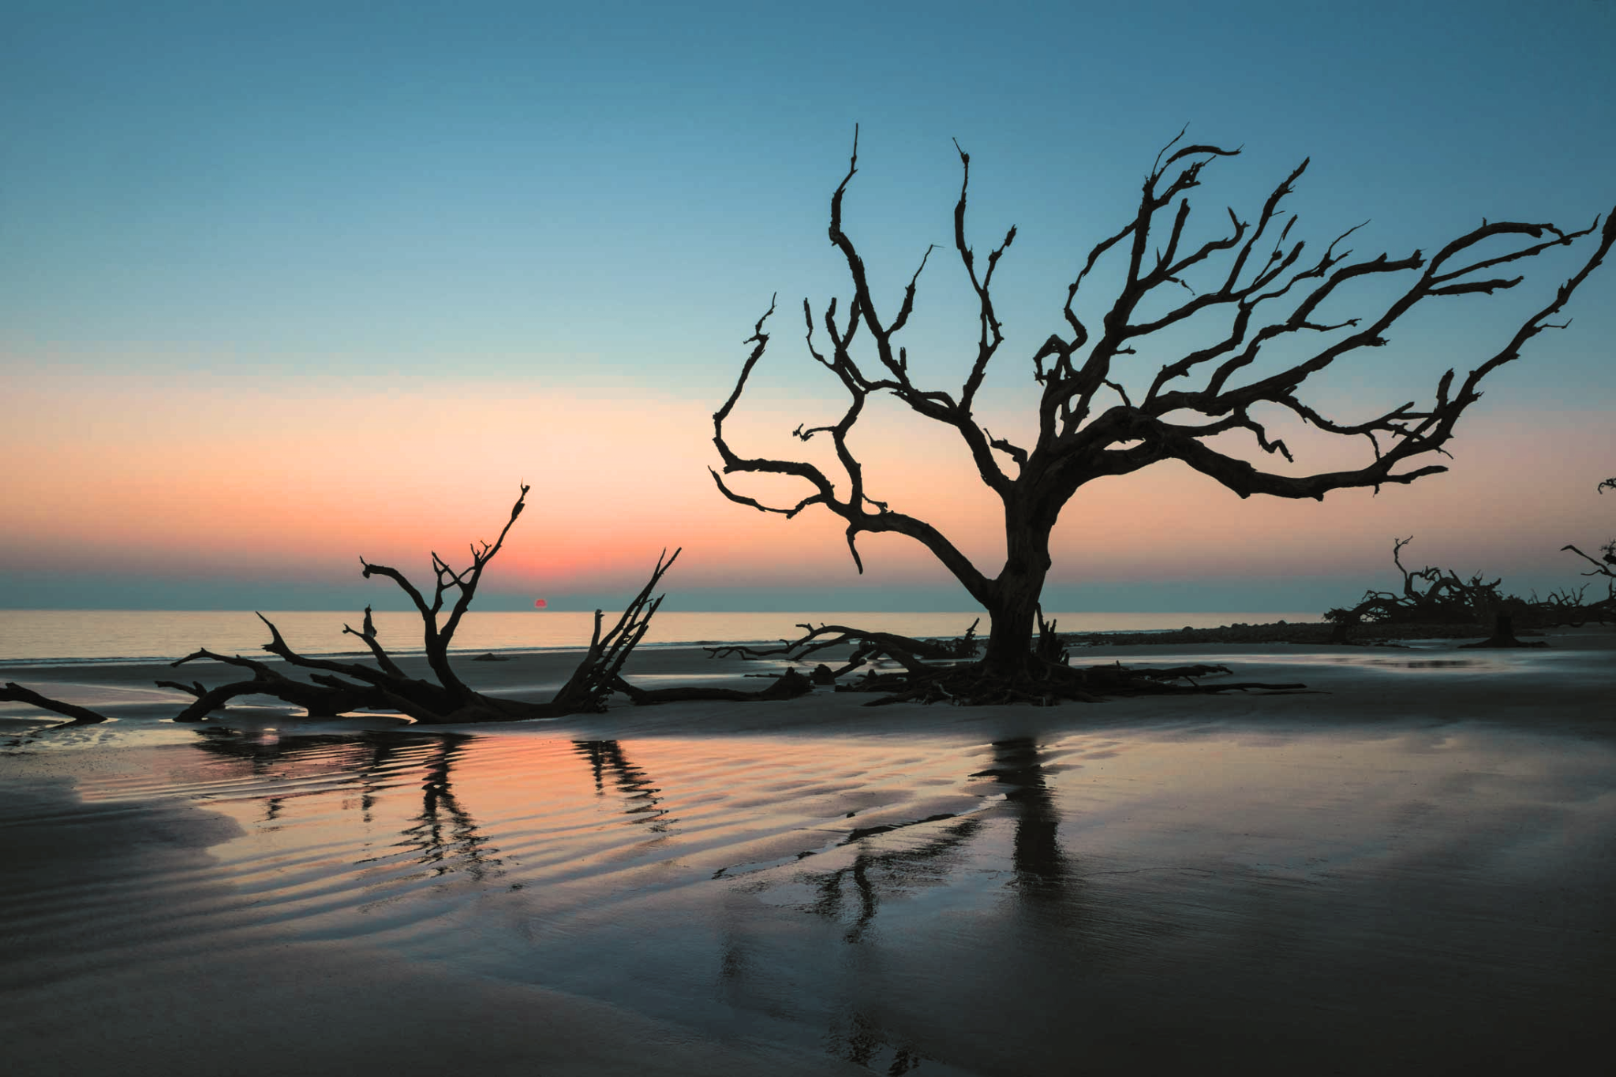

Our Mission
Enhance community standing through conservative management.
Find the right balance of profitability, risk, and growth.
Build a stable base for the future of the bank and our shareholders.
Notes:
With that said, we took on the challenge focusing on 3 items:
- Conservative management
- Finding a balance between profitability, risk, and growth
- Building a stable base for the future

Slide 4
New Team, New Start
ASSETS
LOANS
DEPOSITS
ROE
ROA
NIM
$781MM
$628MM
$671MM
3.85%
0.24%
3.24%

Slide 5
Initial Concerns
EARNINGS
GROWTH
EXPENSES

Slide 6
Objectives
Prioritize Profitability
Grow Assets to $850MM
Protect Shareholder Investment
Ensure Future Stability & Trust

Slide 7
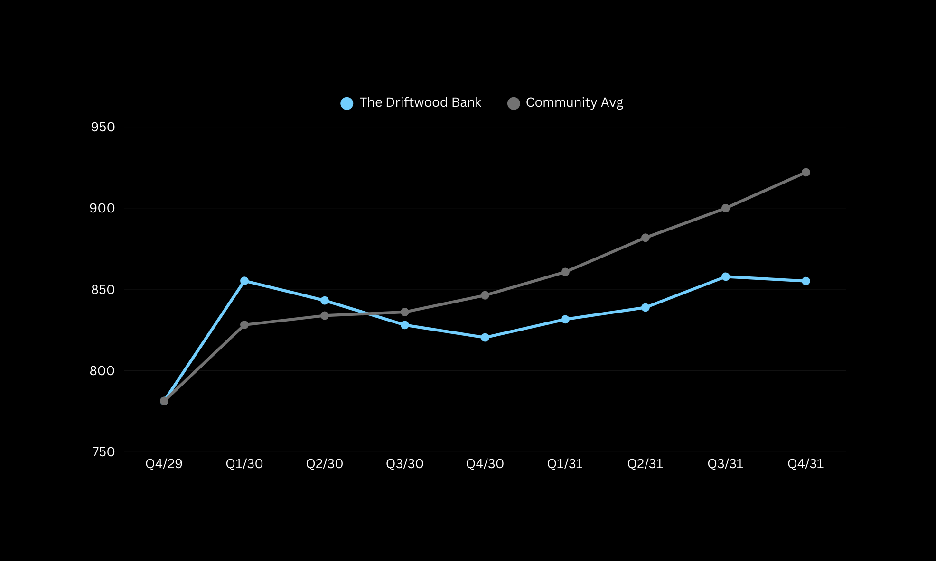
Total Assets
Notes:
Key Take Away: We are a smaller bank with a controlled size

Slide 8
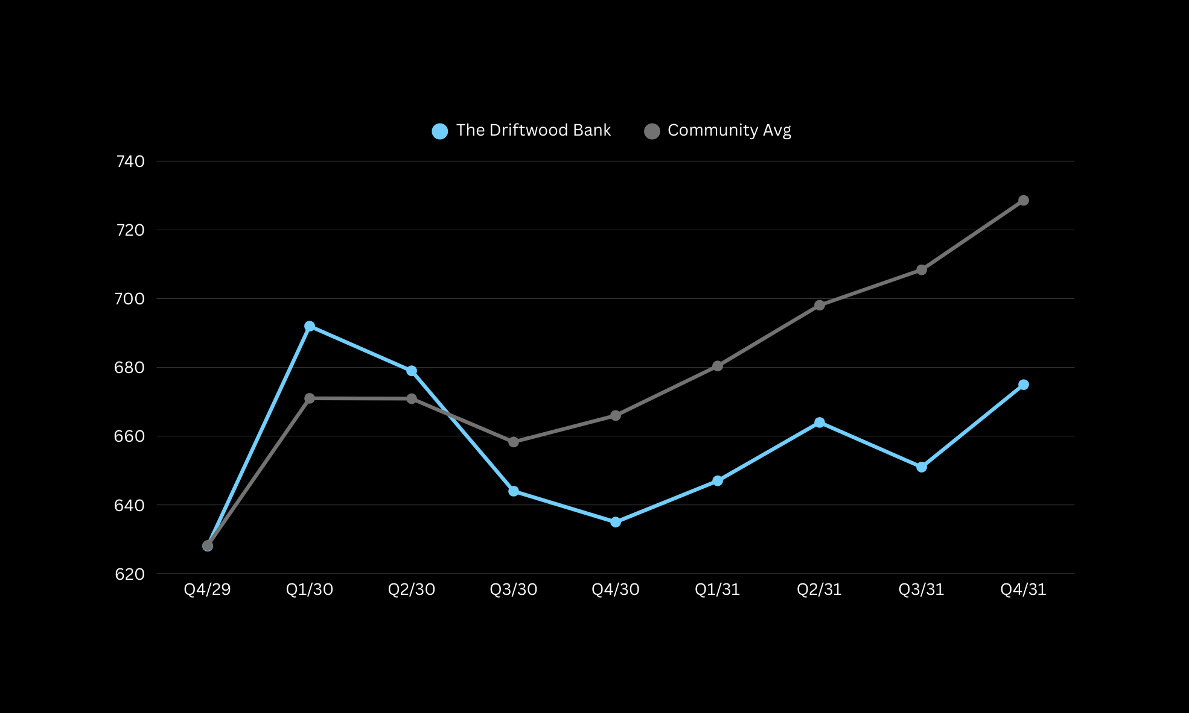
Total Loans
Notes:
Didn't understand the sensitivity of the model and the need in the market
- What happened?
- Were there challenges?
- What did we do to effect change?
- How did we end up?

Slide 9
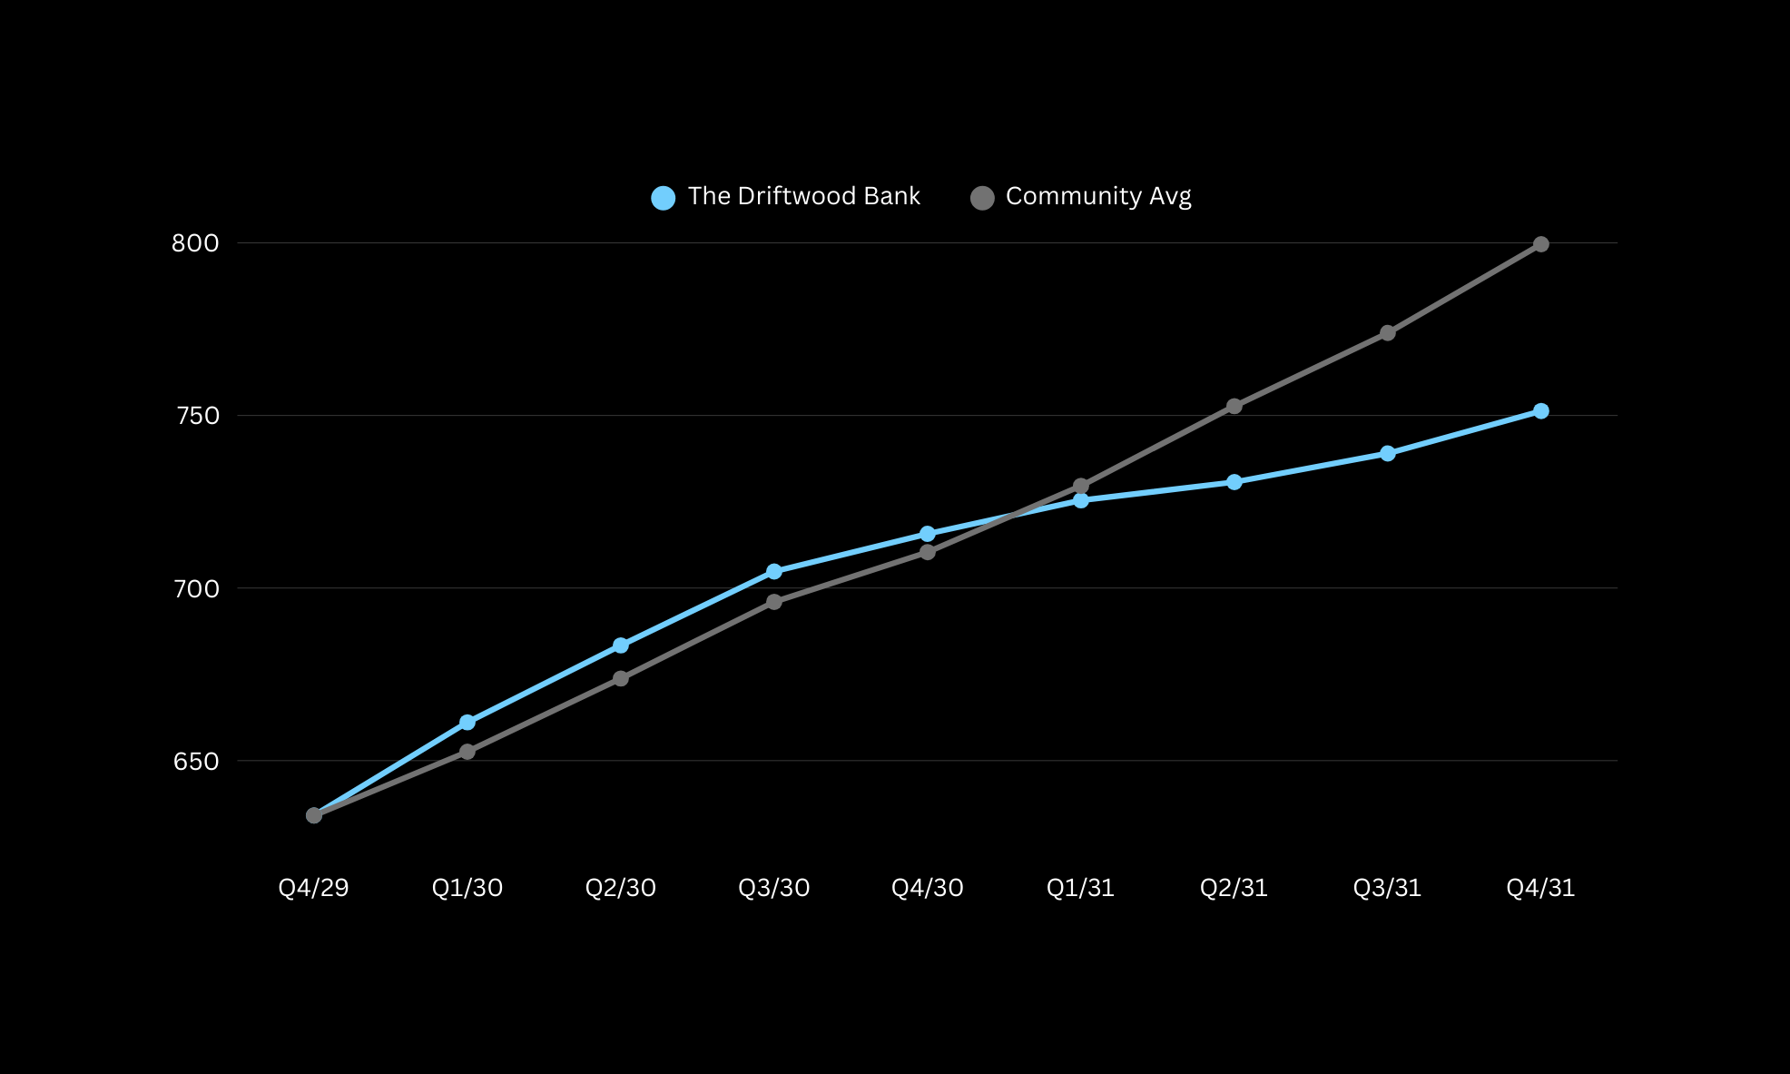
Total Deposits

Slide 10
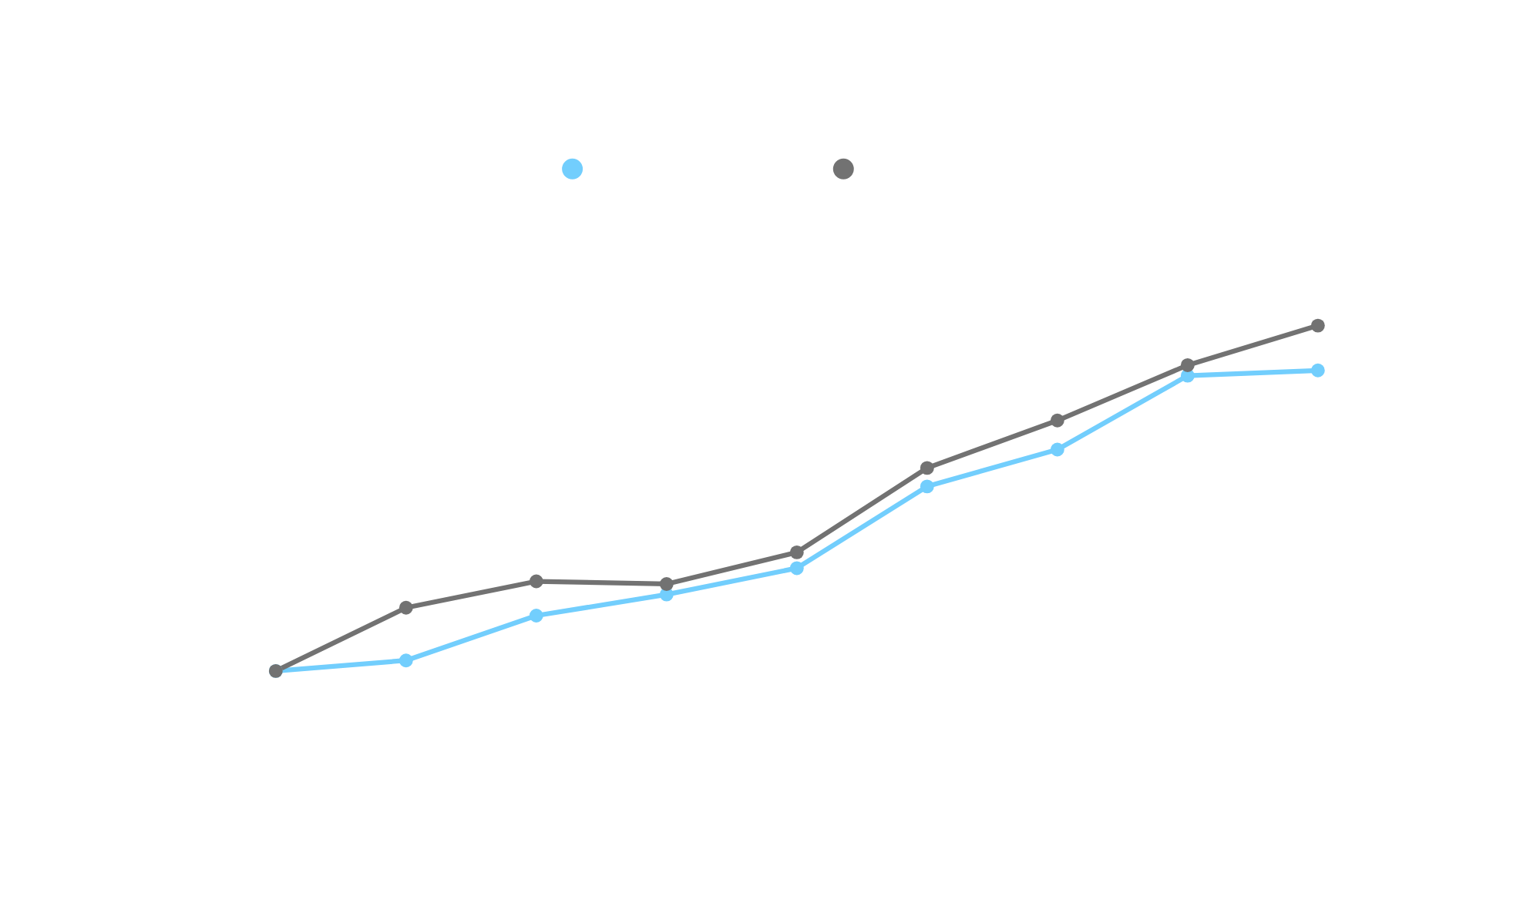
Return on Assets

Slide 11
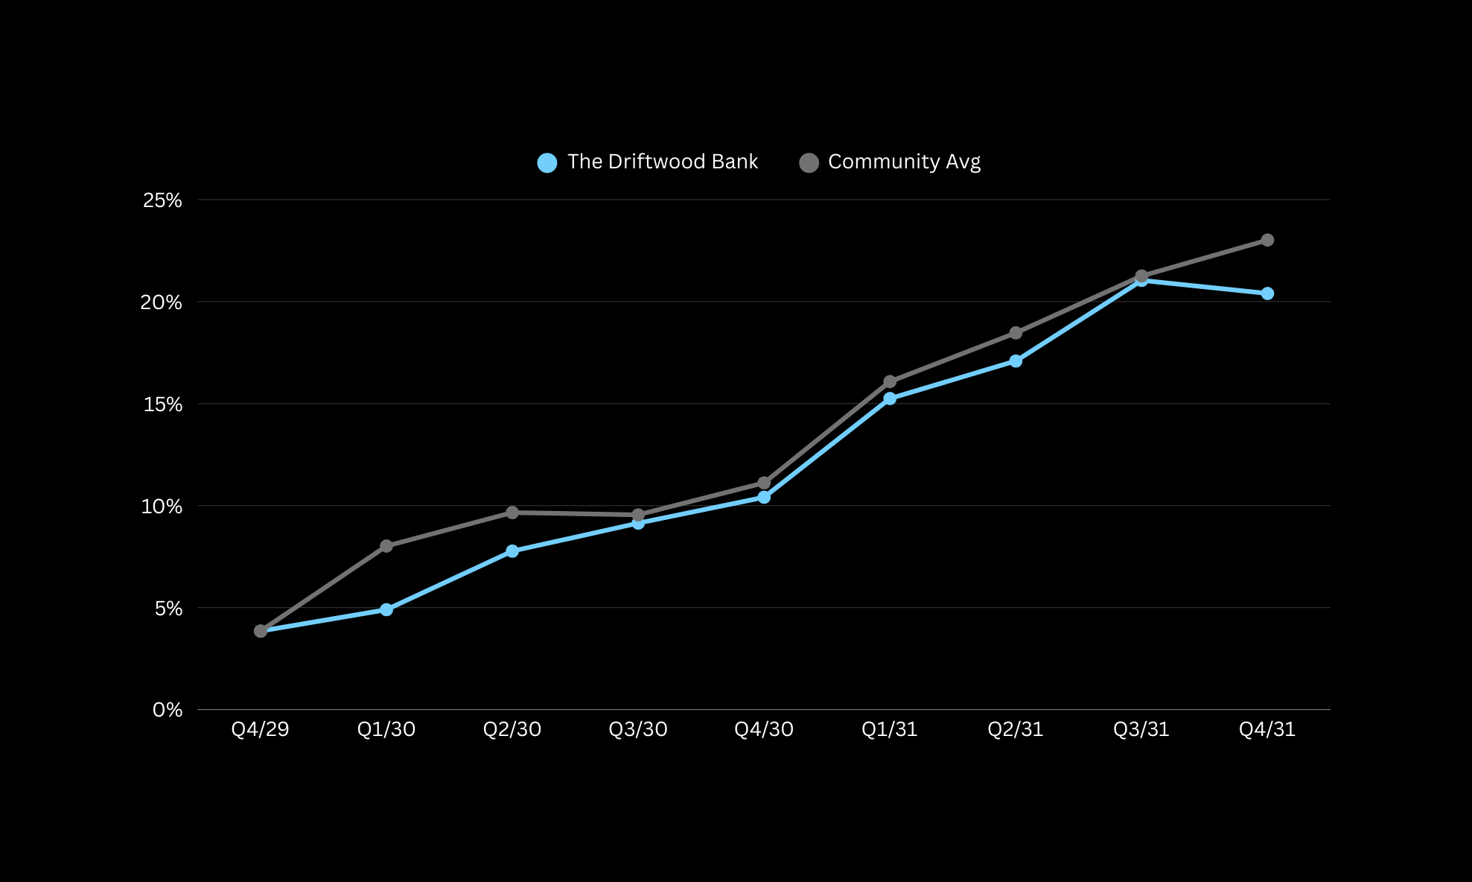
Return on Equity

Slide 12
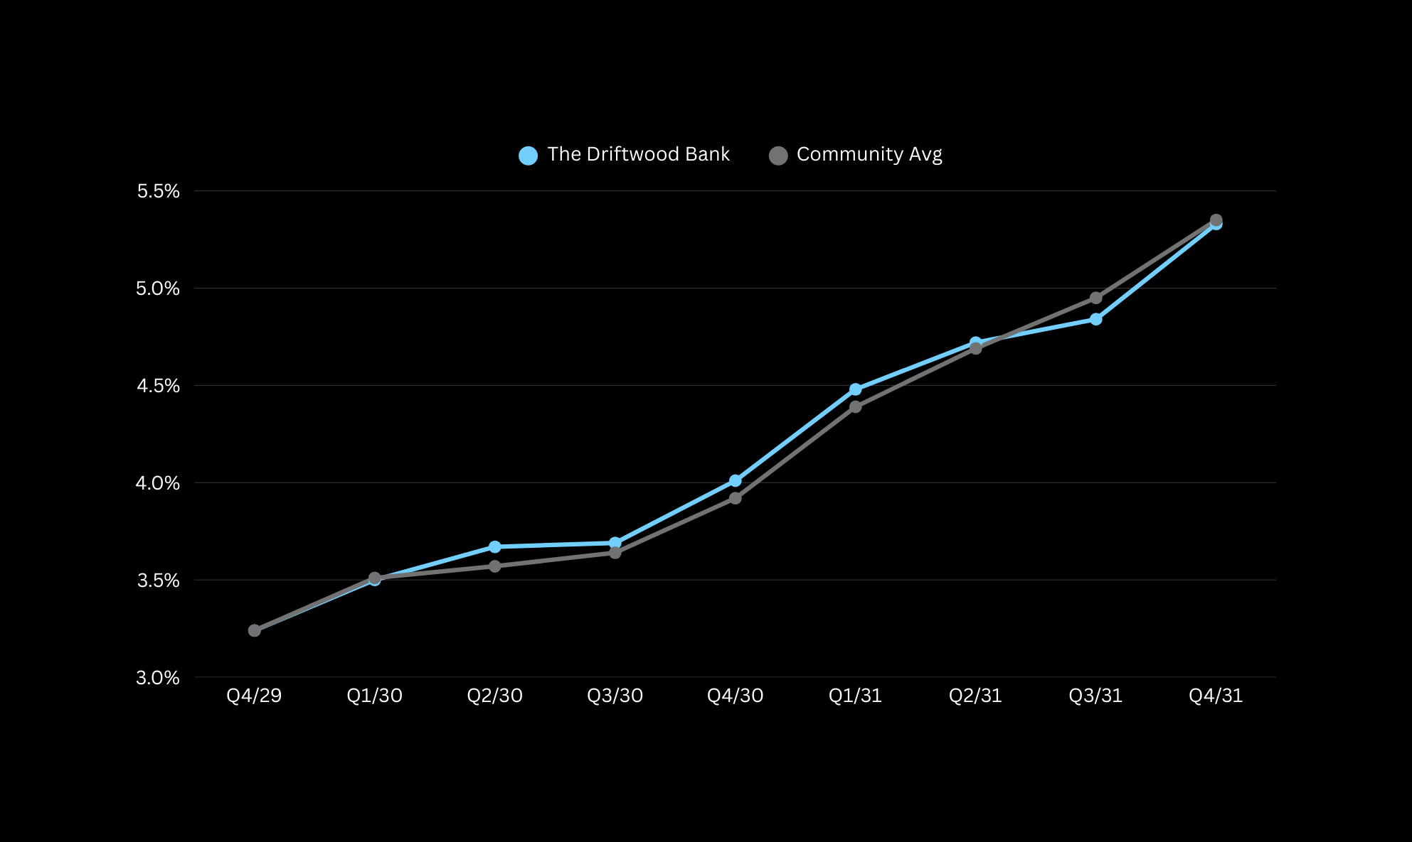
Net Interest Margin

Slide 13
The Results
Total Assets
Net Income
Stock Price
NIM
$855MM
$2.95MM
$38.14
5.33%
$781 MM
$0.458 MM
$17.72
3.24%
NO REGULATORY VIOLATIONS!
Notes:
9.5% Total Assets
544% Net Income
115% Stock Price
65% NIM

Slide 14

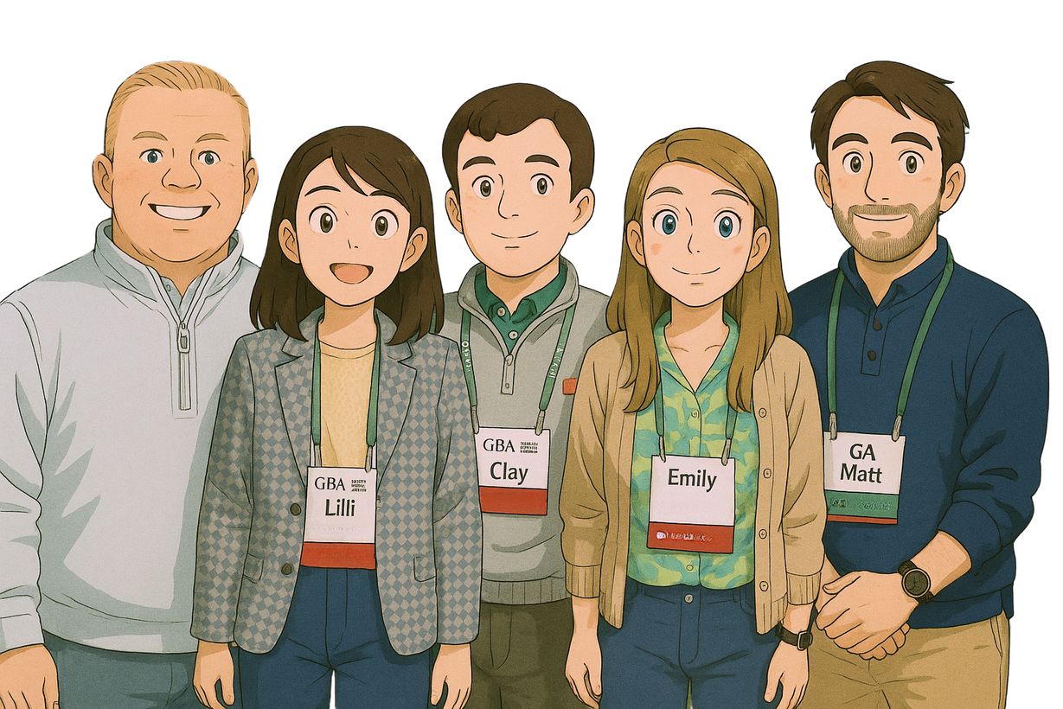
Grow with us!

