Slide 1


Slide 2
Executive Team

Slide 3
Where We Started
Loans $628.240M
Total Assets $781.093M
Total Deposits $671.270M
ROA .24%
ROE 3.85%
Stock Price $17.72

Slide 4

Our Goal: Profitability

Slide 5
LOAN & DEPOSIT GROWTH OVER THE LAST 2 YEARS.
Strategic Growth

Slide 6
SECURITIES
$104.469
$64.843
DEPOSITS
$671.270
$832.731

Slide 7
CORE DEPOSIT

Slide 8
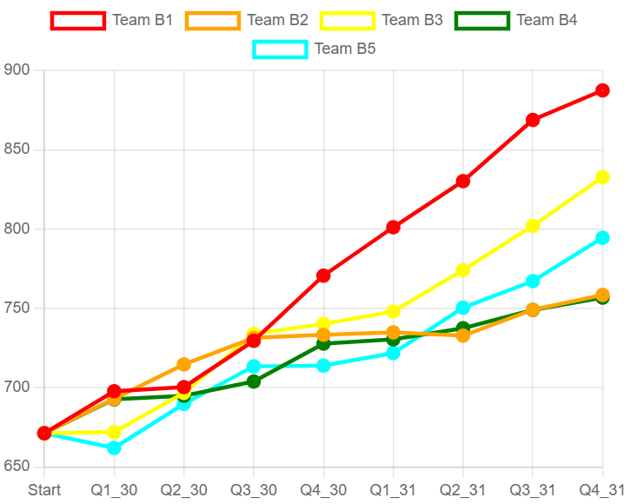
DEPOSIT
GROWTH

Slide 9
LOAN
GROWTH

Slide 10
SUSTAINABLE GROWTH AND PROFIT PERFORMANCE

Slide 11
RETURN ON ASSETS

Slide 12
RETURN ON EQUITY

Slide 13
NET
INTEREST
MARGIN

Slide 14
STOCK
PRICE
COMPARISON

Slide 15
Dec. 31, 2029 vs. Dec. 31, 2031
Loans : $628.240M
Total Assets: $781.093M
Total Deposits: $671.270M
ROA: .24%
ROE: 3.85%
Stock Price: $17.72
Credit Rating: B
Loans: $720.687M
Total Assets: $939.732M
Total Deposits:$832.731M
ROA: 1.82%
ROE: 27%
Stock Price: $44.93
Credit Rating: AA

