Slide 1

Notes:
Donna - Good morning and thank you for being here. Our team will present information relative to the changes for ReliaBank over an 8-quarter period.

Slide 2

Presentation Overview
Our Mission
Meet the Team
Our Findings
Our Strategy for Improvement
Summary & Outlook
Notes:
Donna - Our presentation will include information about our mission. We’ll introduce you to our team, share the findings, our strategy for improvement and our outlook for the future.

Slide 3

Executive Team
Notes:
Donna - Let me introduce our executive team.

Slide 4
OUR MISSION
“ReliaBank is dedicated to empowering employees, supporting customers, rewarding our shareholders, and enriching our communities with trusted financial solutions.”
Notes:
Ashton

Slide 5

Our Strategy for Improvement
Manage Risk
Enhance Profitability
Control Growth
Increase Shareholder Value
Notes:
Ashton

Slide 6
Profitability Ratios
 | 12/31/29 | 12/31/31 | Percent Change
Net Interest Margin | 3.24% | 5.20% | +60%
Return on Assets | 0.24% | 1.48% | +517%
Return on Equity | 3.85% | 21.7% | +465%
Efficiency Ratio | 77.98% | 59.05% | -24%
Notes:
Jacob

Slide 7
Key Metrics
 | 12/31/29 | 12/31/31 | Percent Change
Equity / Total Assets | 6.10% | 6.76% | +11%
Earnings Per Share | $0.23 | $1.60 | +596%
Stock Price | $17.72 | $39.39 | +122%
Dividends | $0.25 | $0.30 | +20%
Net Income | $458M | $3,027M | +600%
Notes:
Jacob

Slide 8
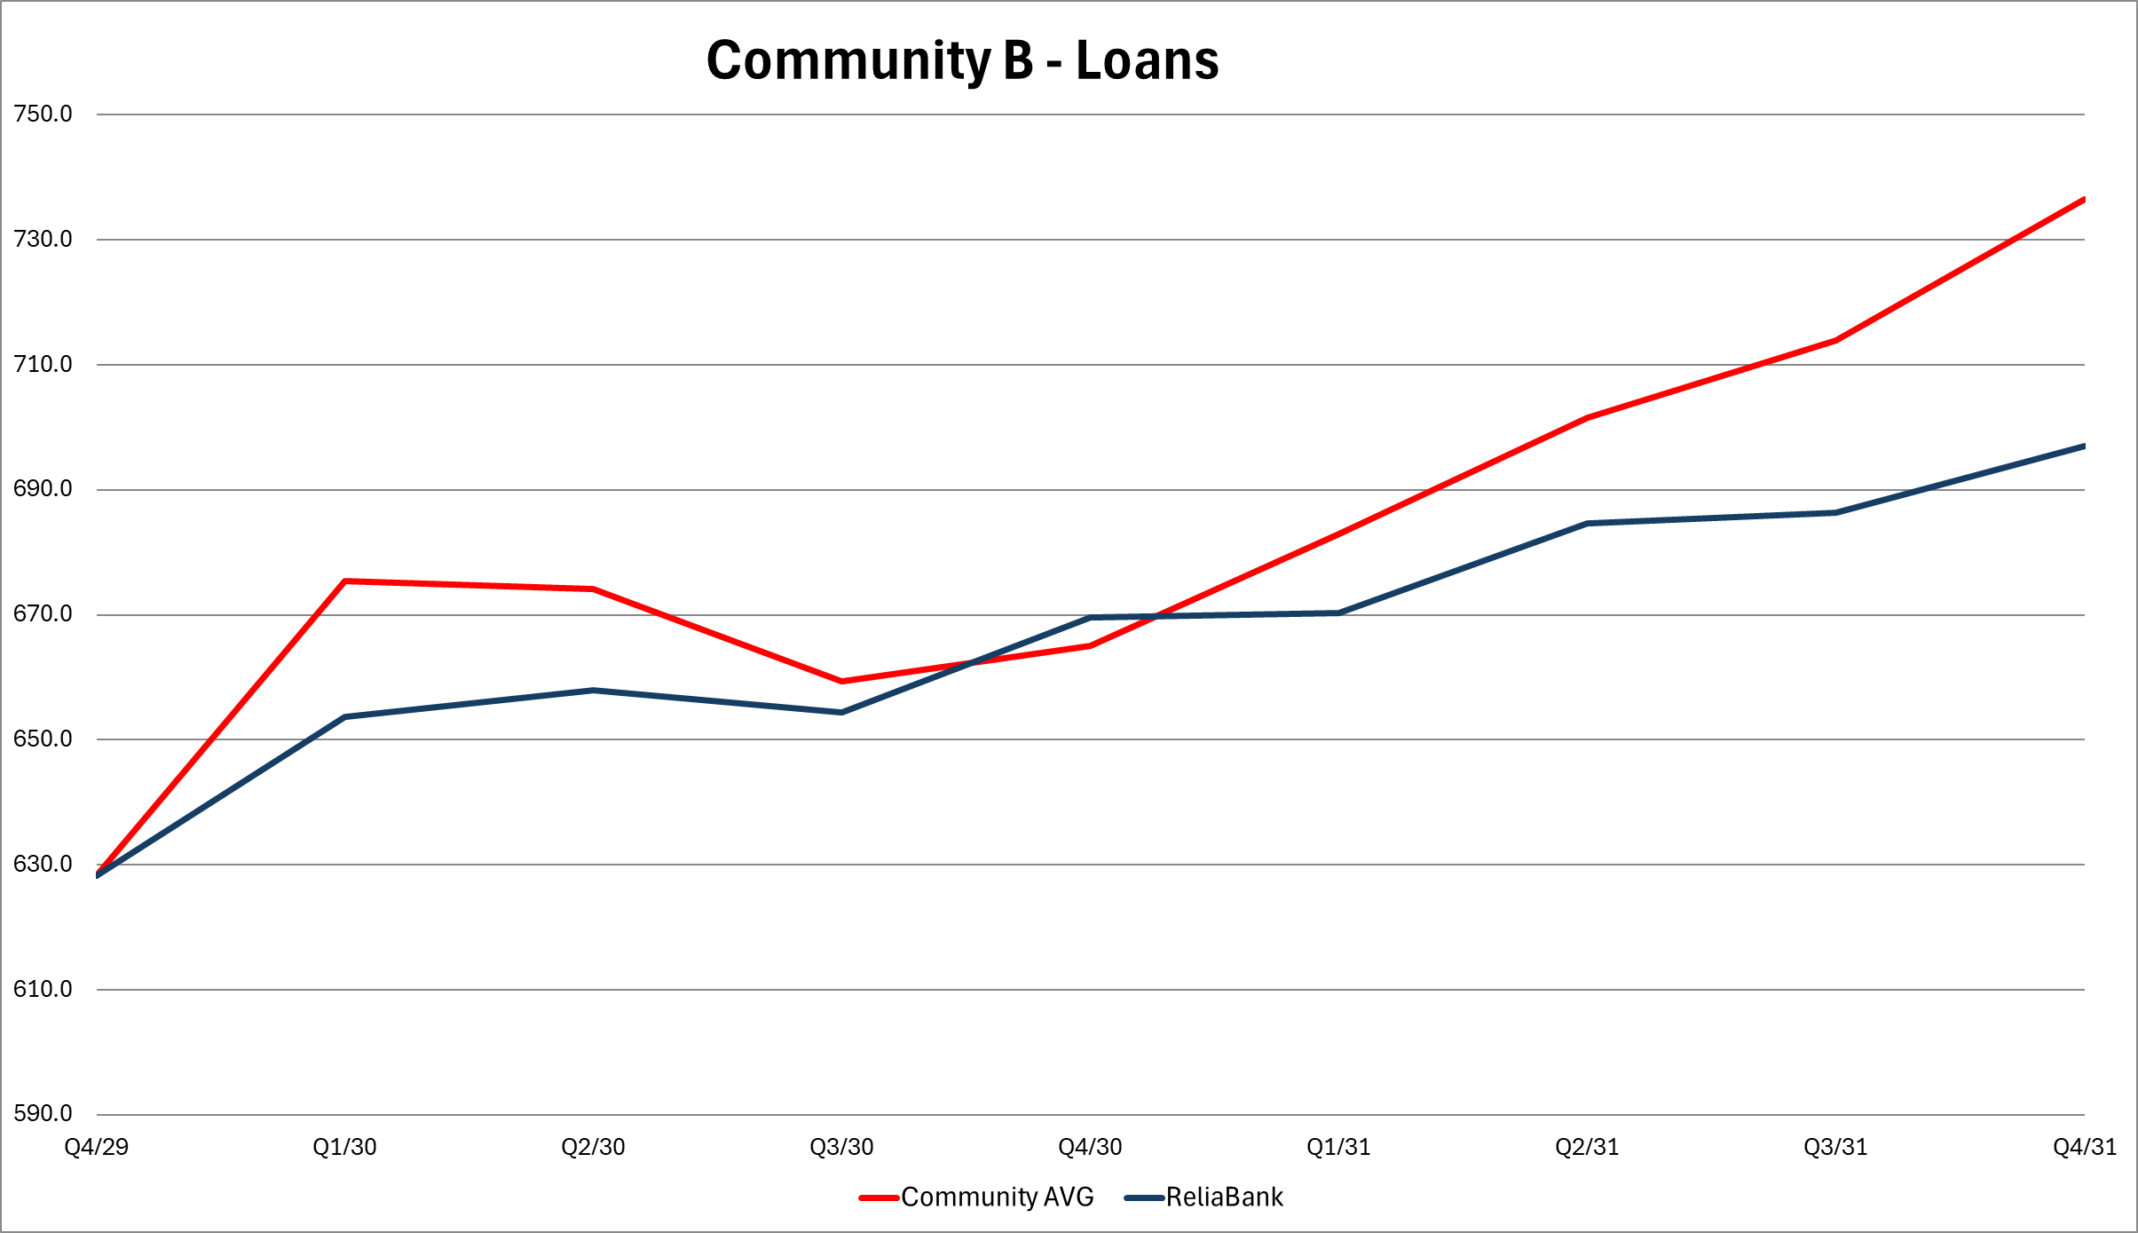
$630MM $697MM = 11% Growth
Notes:
Jesse

Slide 9
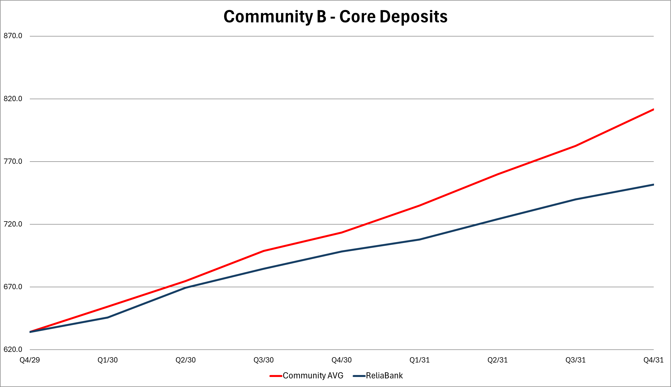
$671MM $756MM = 13% Growth
Notes:
Jesse

Slide 10
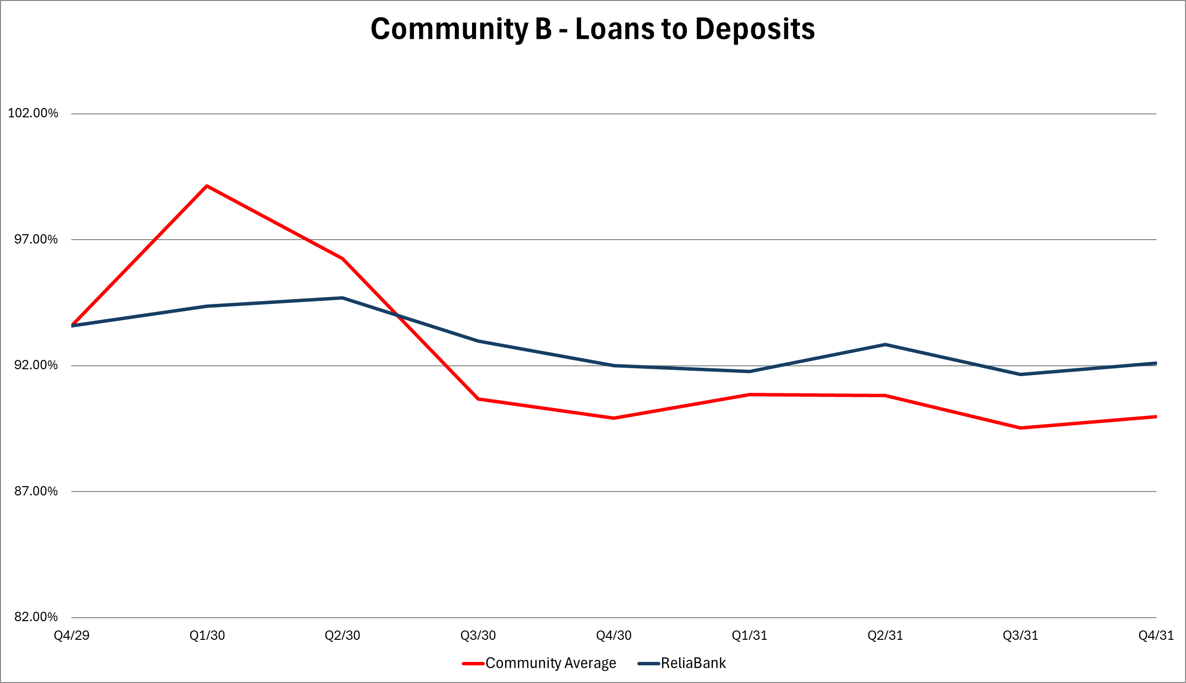
93.6% 92.1% = 2% Change
Notes:
Jesse

Slide 11
Summary & Outlook
Strong Financial Close in 2031
Well Diversified & High Quality Loan Portfolio
Low Credit Risk & Strong Capital
Optimally Positioned for 2032 in a Rising Rate Environment
Notes:
Cody

Slide 12
ReliaBility
=
Profitability

Slide 13
Questions?
Thank You

