Slide 1

Athens, Georgia

Slide 2
Executive Team

Slide 3
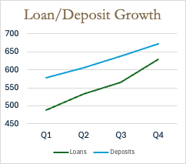
Starting Position

Slide 4
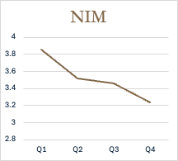
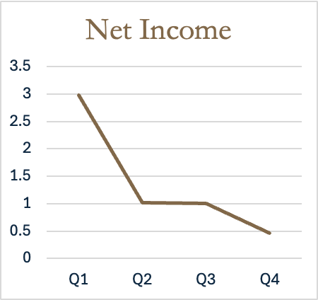

Starting Position

Slide 5
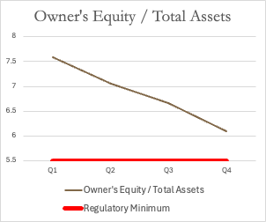
Starting Position

Slide 6
Profit with peace of mind
Reliable profits for dividends and reinvestment
Controlled growth
Risk management

Slide 7
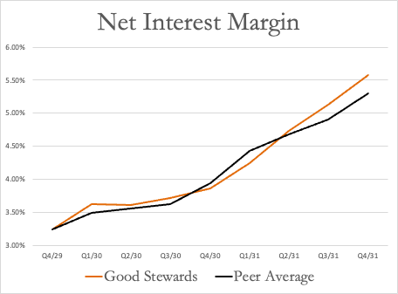

Reliable Profits
5.58%

Slide 8
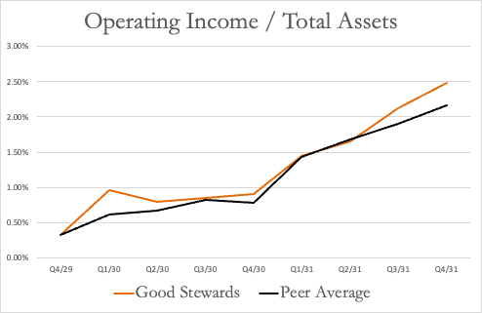
Continuous Improvement in Operating Earnings

Slide 9
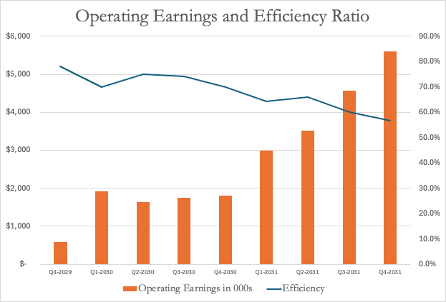
Continuous Improvement in Operating Earnings

Slide 10
ROA: 0.24% → 1.64%
ROE: 3.85% → 24.49%

Slide 11
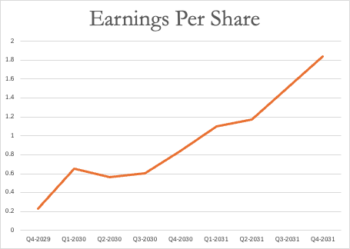
Value for Shareholders
+183%

Slide 12
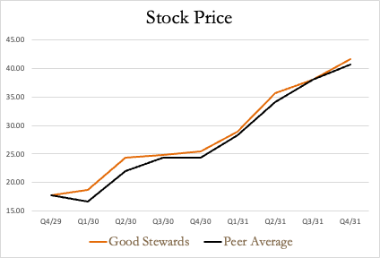
Value for Shareholders
+135%

